Slide 1
7-1 Agile Presentation
Anthony Cunningham

Slide 2
Roles on a Scrum-agile Team
Product Owner – Responsible for maximizing the value of the product and the work of the development team. They are the sole person responsible for managing the Product Backlog.
Scrum Master – A servant-leader for the Scrum Team and Product Owner. Ensures Scrum is understood and enacted by ALL parties.
Team - The Development Team consists of professionals who do the work of delivering a potentially releasable increment of "Done" product at the end of each sprint. These teams are structures and empowered by the organization to organize and manage their own work.

Slide 3
Phases of the Software Development Lifecycle (SDLC)
Phase 1 "Planning and Requirements Analysis" - The most important stage in the SDLC. Performed by the senior members of the team with inputs from the customer, the sales department, market surveys, and domain experts in the industry. This information is then used to plan the basic project approach and to conduct product feasibility study in the economical, operational and technical areas.
Phase 2 "Defining Requirements" - Clearly define and document the product requirements and get them approved from the customer or the market analysts. This is done through an SRS (Software Requirement Specification) document which consists of all the product requirements to be designed and developed during the project life cycle.

Slide 4
SDLC Cont.
Phase 3 "Designing the Product Architecture" - Based on the requirements specified in SRS, a DDS - Design Document Specification is produced. This DDS is reviewed by all the important stakeholders, and they choose which design is best. A design approach clearly defines all the architectural modules of the product along with its communication and data flow representation with the external and third-party modules (if any).
Phase 4 "Building or Developing a Project" - In this stage of SDLC the actual development starts, and the product is built. The programming code is generated as per DDS during this stage. If the design is performed in a detailed and organized manner, code generation can be accomplished without much hassle.

Slide 5
SDLC Cont.
Phase 5 "Testing the Product" - this stage refers to the testing only stage of the product where product defects are reported, tracked, fixed and retested, until the product reaches the quality standards defined in the SRS.
Phase 6 "Deployment in the Market and Maintenance" - Sometimes product deployment happens in stages as per the business strategy of that organization. The product may first be released in a limited segment and tested in the real business environment (UAT- User acceptance testing). Then based on the feedback, the product may be released as it is or with suggested enhancements in the targeting market segment. After the product is released in the market, its maintenance is done for the existing customer base.

Slide 6


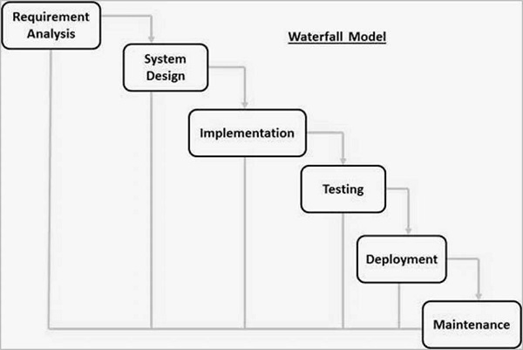
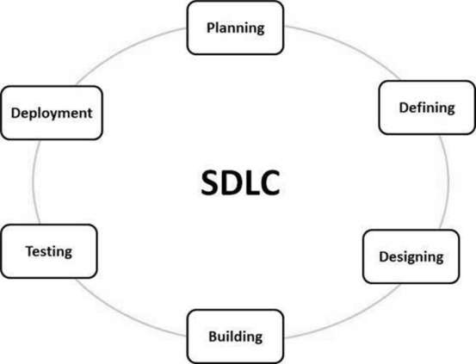



Differences Between Waterfall and Agile Methodology Phases

Slide 7
Agile and Waterfall Comparison Chart
"The main differences between these two methodologies is that waterfall is a linear system of working that requires the team to complete each project phase before moving on to the next one while Agile encourages the team to work simultaneously on different phases of the project."
Waterfall
Agile
Has a fixed timeline
Once the end goal is established, Waterfall does not involve the client or project owner during the process, apart from specific check-ins or for deliverables.
Waterfall is not as flexible as Agile because each phase needs to be fully completed before moving on to the next phase.
The budget for projects using the Waterfall methodology is generally fixed.
Rather than a fixed timeline, the schedule adapts as the project progresses.​
A fundamental part of Agile is including clients in the project development at every step. ​
Flexibility is built into the Agile method. Agile values short bursts of work, which are called sprints.​
Agile is open to adaptation, encourages experimentation and welcomes changes of direction, even in later phases of the project. Because of this, the budget tends to be more flexible.

Slide 8
Factors to Consider when Choosing Waterfall or Agile
Waterfall
Agile
Requirements are very well documented, clear and fixed.
Product definition is stable.
Technology is understood and is not dynamic.
There are no ambiguous requirements.
Ample resources with required expertise are available to support the product.
The project is short.
A LOT less risk involved as the project is broken into much smaller parts for completion
The highest priority is to satisfy the customer through early and continuous delivery of valuable software.
Welcomes changing requirments
Business people and developers must work together daily throughout the project

Slide 9
References
Charles G. Cobb. (2015). The Project Manager’s Guide to Mastering Agile : Principles and Practices for an Adaptive Approach. Wiley.
Chapter 3 Scrum Overview
Tutorials Point (I) Pvt. Ltd. (2017). SDLC - Overview. Tutorials Point Simply Easy Learning. Retrieved April 16, 2023, from http://www.tutorialspoint.com/sdlc/sdlc_overview.htm
Hoory, L. (2022, August 10). Agile vs. waterfall: Which project management methodology is best for you? Forbes. Retrieved April 16, 2023, from https://www.forbes.com/advisor/business/agile-vs-waterfall-methodology/

